Slide 1





Auto Analytics USA
Team names
Esraa Magdy
Mohamed Emad
Ahmad Bahi
Ahmad Abo-Elfadl
Get Started
Watch Video
Supervised by : Dr. Amal Mahmoud

Slide 2
Auto Analytics USA
Team names
Esraa Magdy
Mohamed Emad
Ahmad Bahi
Ahmad Abo-Elfadl
Get Started
Watch Video
Supervised by : Dr. Amal Mahmoud

Slide 3

Agenda
Introduction
Project objective
Methodology
Conclusion and insights

Slide 4


INTRODUCTION
This project aims to explore and evaluate the sales performance of the various car companies and dealerships across multiple regions in USA.
The project involves analyzing customer data, car brands, prices, and revenue trends to gain meaningful business insights.
Interactive dashboards have been developed to track key performance indicators (KPIs), identify market trends, and understand customer behavior.
This analysis supports strategic decision-making, improves marketing and sales operations, and enhances the efficiency of dealer and inventory management.

Slide 5





SCOPE
USA Regions
Car company
Car body style
Duration
7
30
5
2022 -2023

Slide 6


Project objectives
Analyze car sales trends in the USA.
Identify the best-selling car models and brands.
Analyze buyer behavior by gender.
Compare sales data across two years.
Evaluate dealer performance by name.
Identify regional differences in dealership sales.

Slide 7


Methodologies
Excel
For quick analysis and visualization.
SQL
For querying and managing datasets.
Python
For advanced statistical analysis and modeling.
Tableau & power bi
For quick analysis and visualization.

Slide 8

Methodologies
Excel
We did the following using Excel:
Data Modeling
Data Cleaning
Data Analysis and Extracting Insights

Slide 9

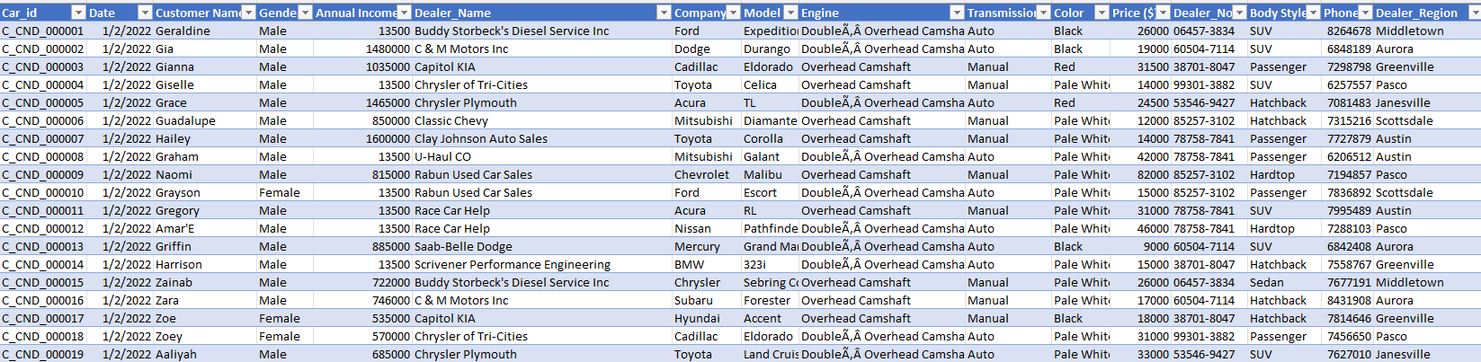
Excel
Raw data

Slide 10
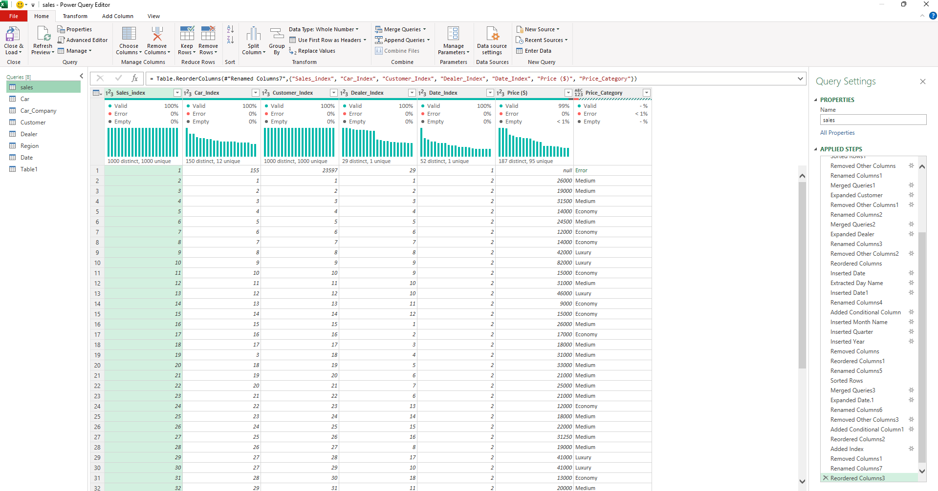
Excel
Data Preprocessing

Slide 11
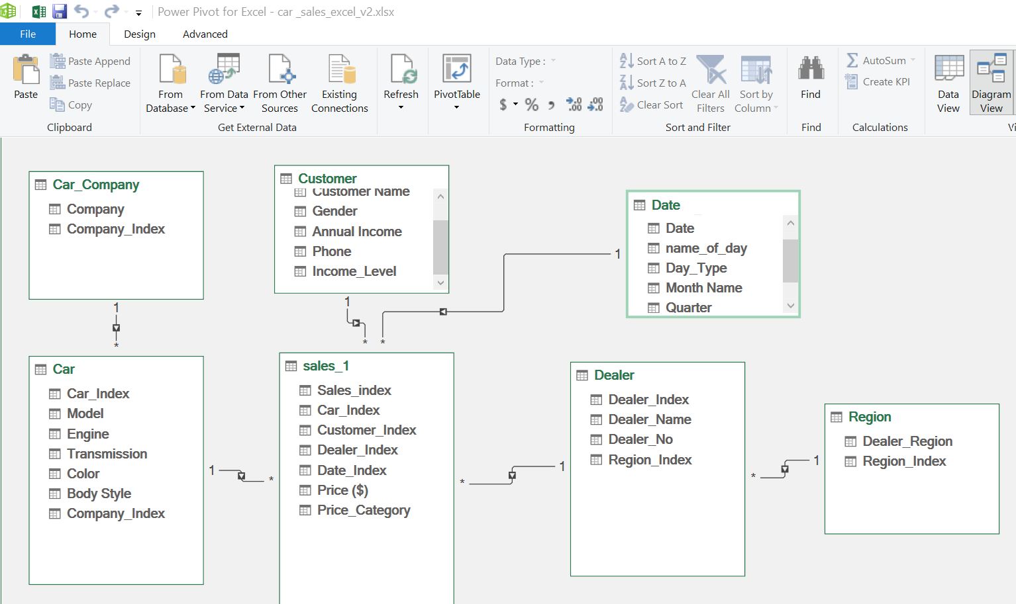
Excel
Data Modelling

Slide 12
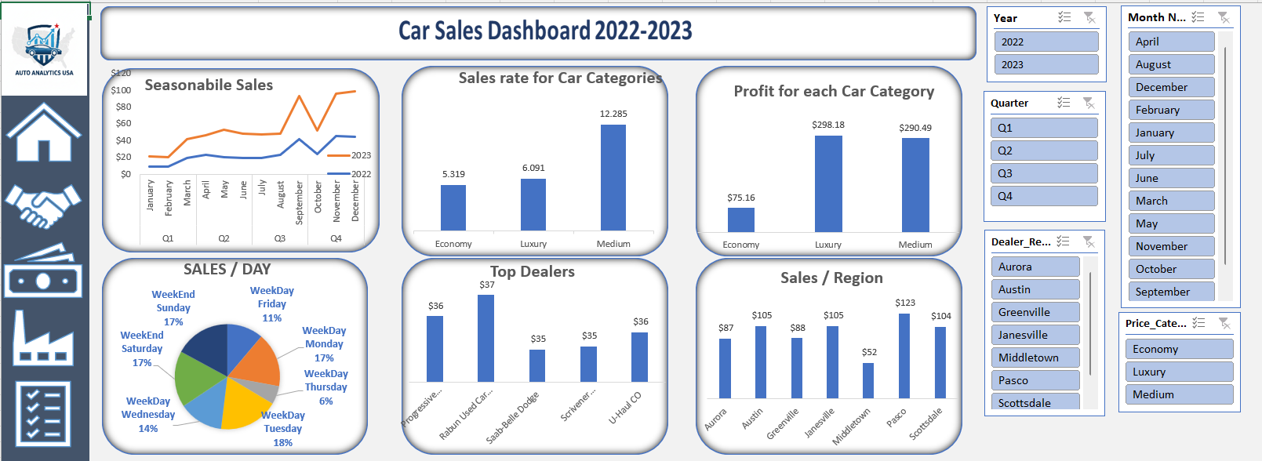
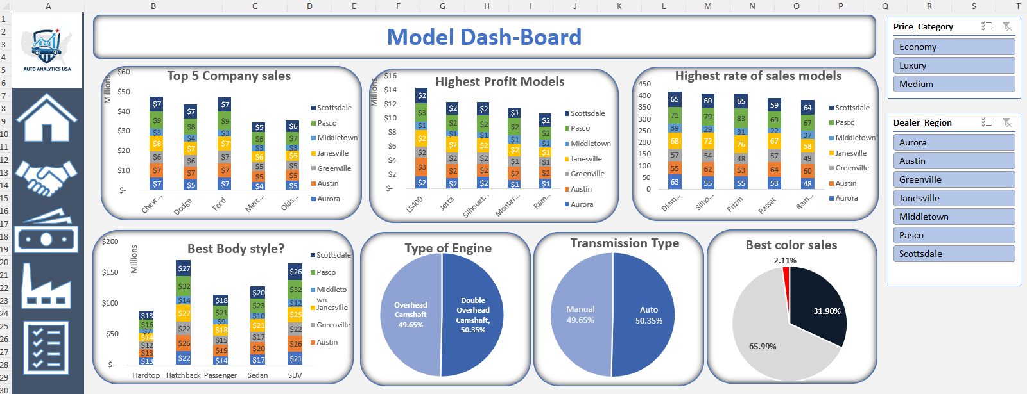
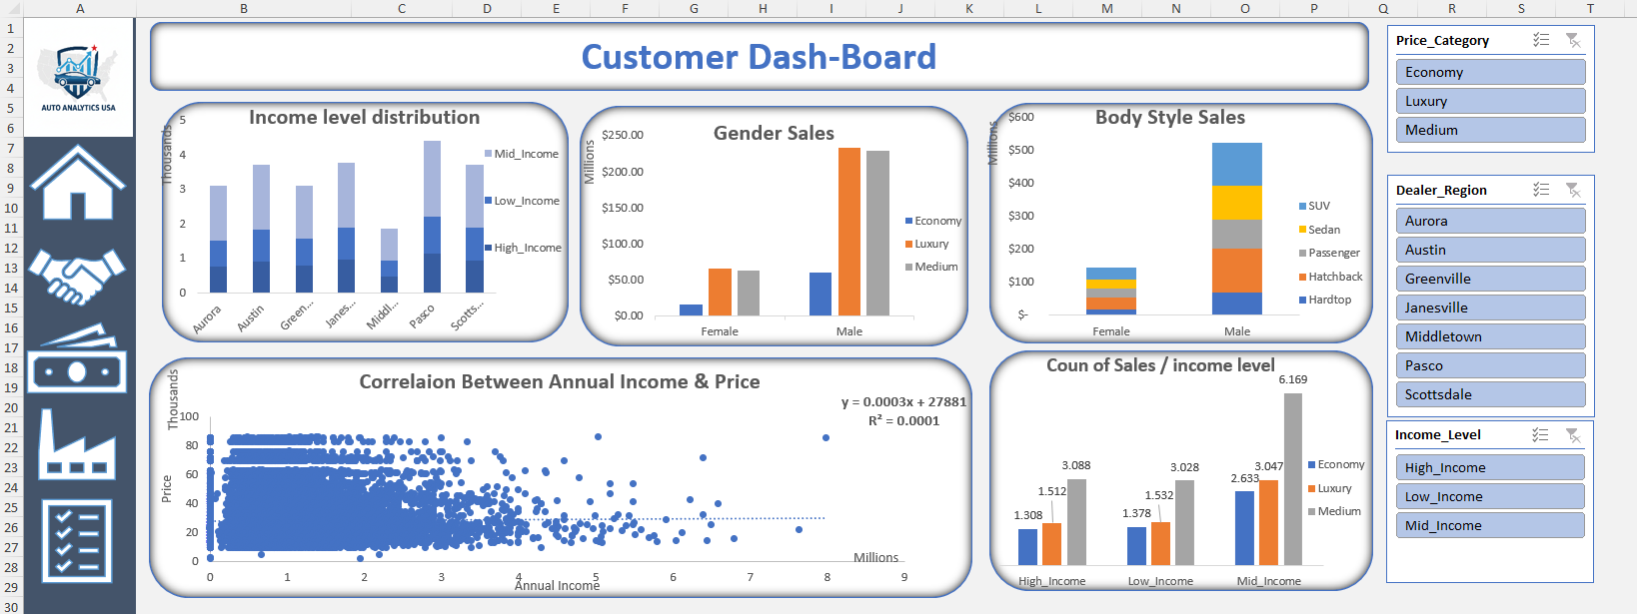
Excel
Dashboard

Slide 13
Methodologies
SQL
We did the following using SQL:
Data Modeling
Data Cleaning
Data Analysis and Extracting Insights

Slide 14
SQL
Data Cleaning
We did the following:
Check duplicate data and remove them
Check missed data and replace them
Add some new columns to make some calculations.

Slide 15
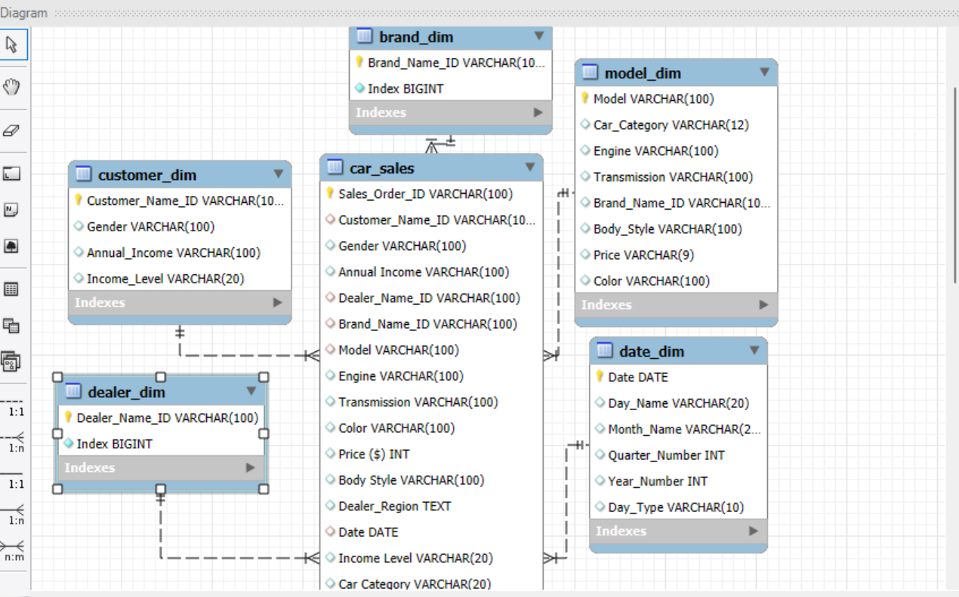
SQL
Data Modeling

Slide 16
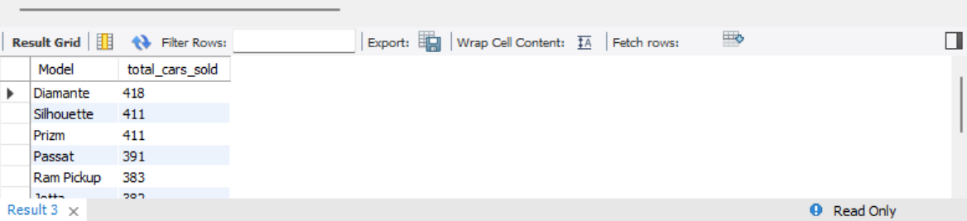
SQL
Data Analysis
what are models that makes most sales orders ?

Slide 17
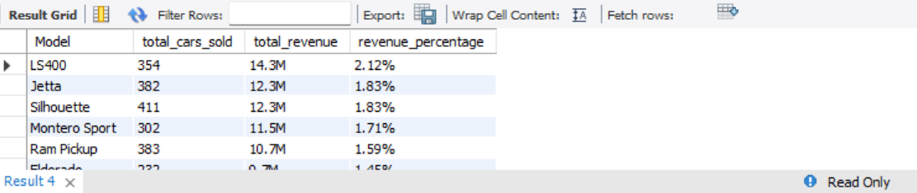
SQL
Data Analysis
what are the most profitable sold models?

Slide 18
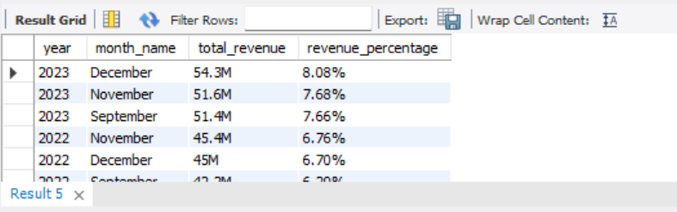
SQL
Data Analysis
what is the month that makes highest sales?

Slide 19
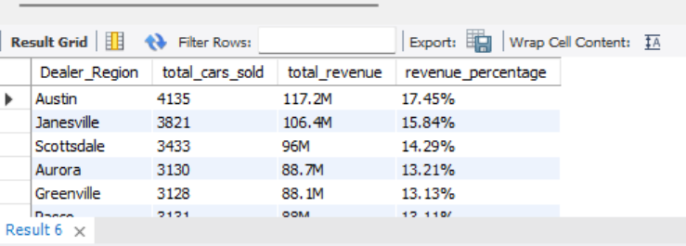
SQL
Data Analysis
Which region makes the highest sales ?

Slide 20
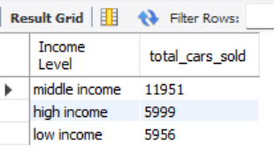
SQL
Data Analysis
What is the most income levels buy cars?

Slide 21
Methodologies
Python
We did the following using python:
Data Loading
Data Cleaning
Data Modeling
Data Analysis and Extracting Insights

Slide 22
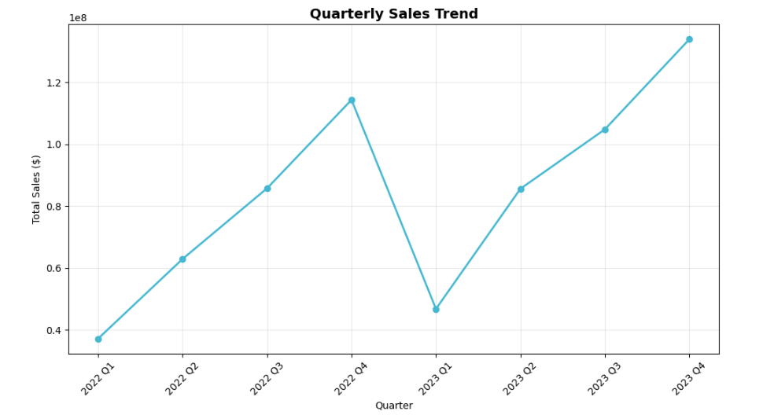
Python
Total sales by quarter

Slide 23
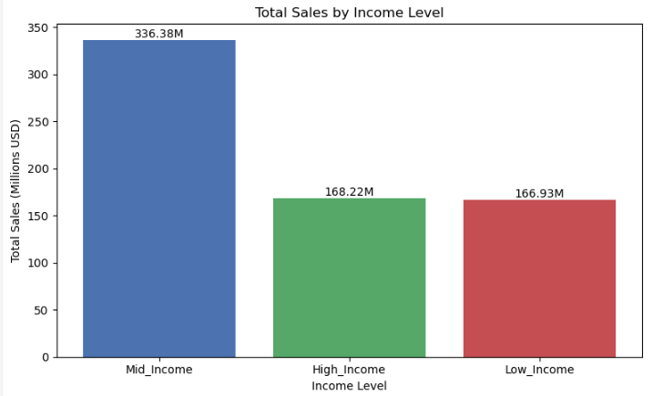
Python
Total sales by income level

Slide 24
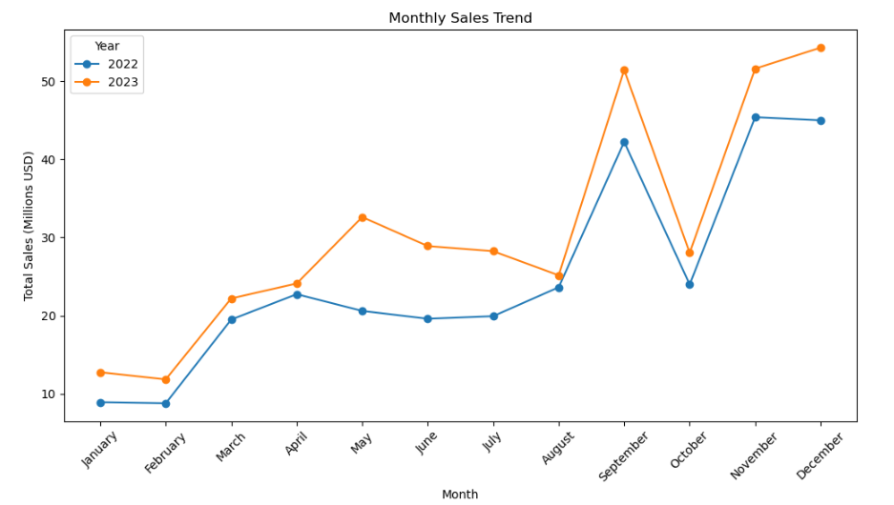
Python
Total sales by month

Slide 25
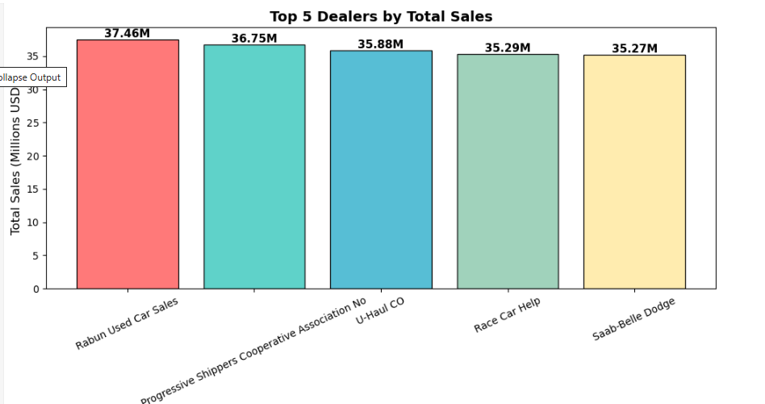
Python
Top 5 dealers by total sales

Slide 26
Methodologies
Tableau
We did the following using Tableau:
Data Loading
Data Modeling
Data Analysis and Extracting Insights

Slide 27
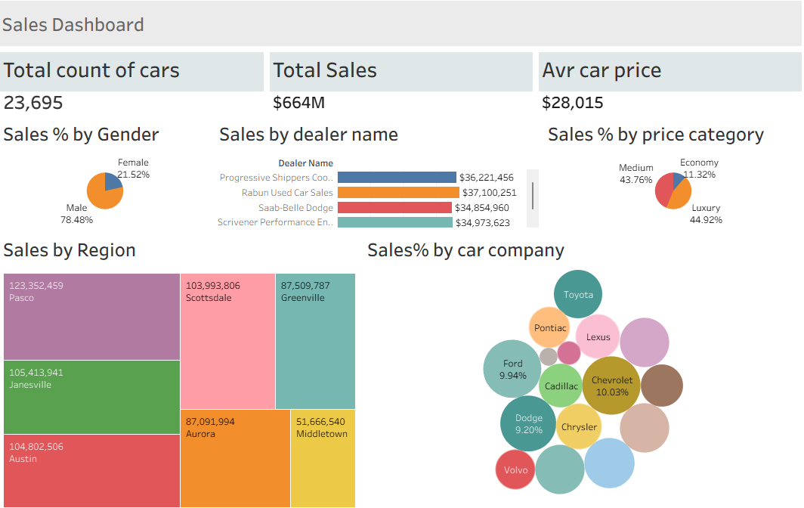
Tableau
Dashboard

Slide 28
Methodologies
Power bi
We did the following using Power bi:
Data Loading
Data Modeling
Data Analysis and Extracting Insights

Slide 29
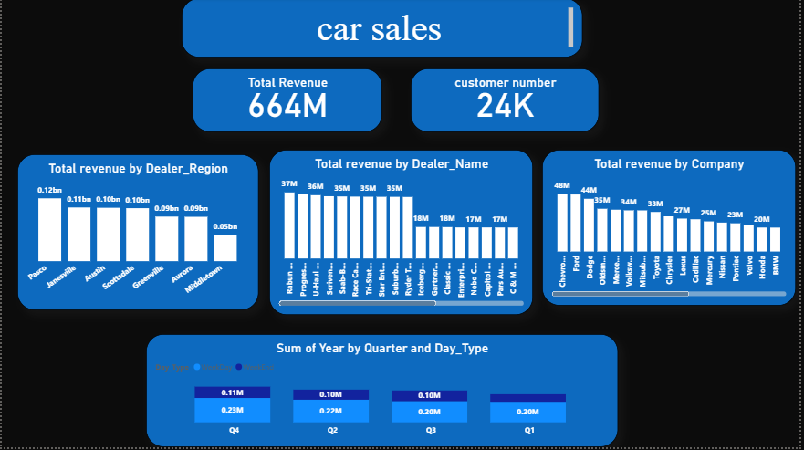
Power Bi
Dashboard

Slide 30


THANK YOU

